Slide 1
Gun Violence in Schools
Name:
School:
Professor:
Date:

Slide 2
Our position as public health nurse on this event
Gun violence definition
Gun violence is an intention to use force/power to cause harm or threaten another person i.e. a student, community or the public which could lead to death.
Our Position
In position for Public Health Nurses, the issue of Gun violence is condemned and we stand to identify potential violence as well as the effects of Gun violence in schools.
The school nurses collaborate with the school administration, health care providers as well as the community to promote violence prevention of any kind including gun violence (National Research Council (U.S.), et. al, 2015).
Notes:
Gun violence is an intention to use force/power to cause harm or threaten another person i.e. a student, community or the public which could lead to death.
In position for Public Health Nurses, the issue of Gun violence is condemned and we stand to identify potential violence as well as the effects of Gun violence in schools.
The school nurses collaborate with the school administration, health care providers as well as the community to promote violence prevention of any kind including gun violence.

Slide 3

Position to end gun violence

Slide 4
Addressing the Issue of Gun Violence
- Public Health Nurses play a vital role in ensuring that the perpetrators of violence are intercepted before they cause harm or injury.
- In order to achieve this mission the Public Health Nurses promote evidence-based programs that fight for gun violence prevention by communication and early intervention, conflict resolution as well as cultivation of positive behavior in schools.
- Cultivate Purposeful behavior within the school and the community
- Educate students as well as the school staff about gun safety (Clanton, 2015)

Slide 5
Addressing the Issue of Gun Violence
To facilitate programs that are important in solving conflicts, monitoring children in school activities.
- Facilitating safety partnership between local healthcare facilities and the school
- Establishing an environment in school and in the community that promotes respect for one another and life.
- Advocating for formation of School Multi-disciplinary team composed of professionals, students, religious clerks to promote discipline and improve school security (Webster, & Vernick, 2013).

Slide 6
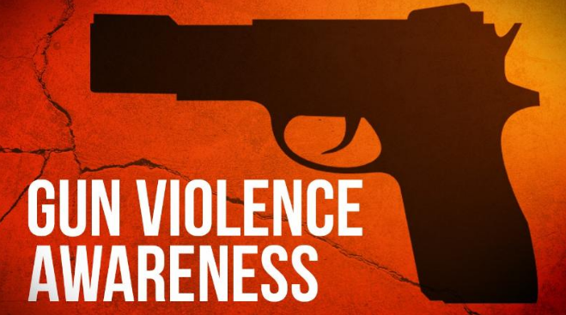
Gun Violence awareness

Slide 7
References
Clanton, H. E. (2015). Group-Centered Prevention in Mental Health: Theory, Training, and Practice. Cham: Springer International Publishing.
National Research Council (U.S.)., Wellford, C. F., Pepper, J., Petrie, C., & National Research Council (U.S.). (2015). Firearms and violence: A critical review. Washington, DC: National Academies Press.
Webster, D. W., & Vernick, J. S. (2013). Reducing gun violence in America: Informing policy with evidence and analysis. Baltimore: Johns Hopkins University Press.

